Slide 1
Thanks for stopping by! Watch our story!

Slide 2
Abilities in Harmony started when our director met and fell in love with two awesome children who love to sing and dance that also happen to have Down Syndrome and Autism!

Slide 3
That inspired her to start a camp for middle and high school students of all abilities to experience the joy of show choir!

Slide 4
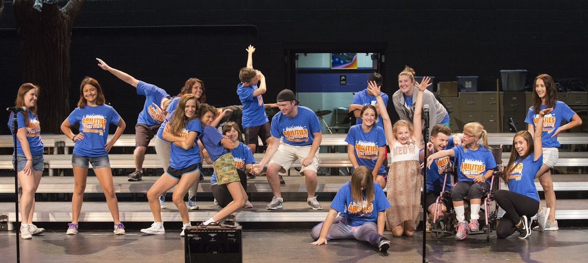
Which led to the first camp in July 2017 with eight participants!

Slide 5
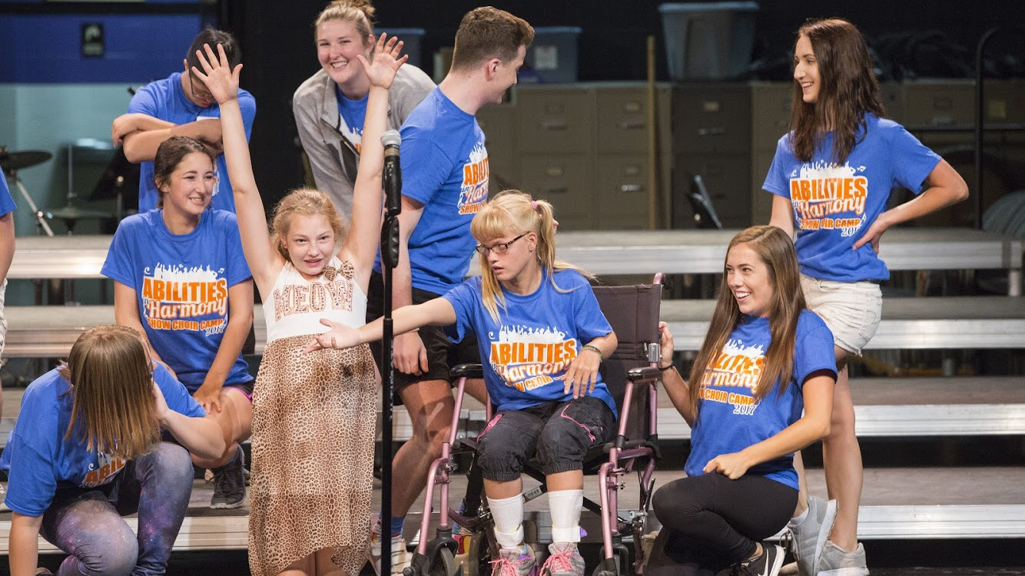
The camp was a big success, so we decided to have another…

Slide 6
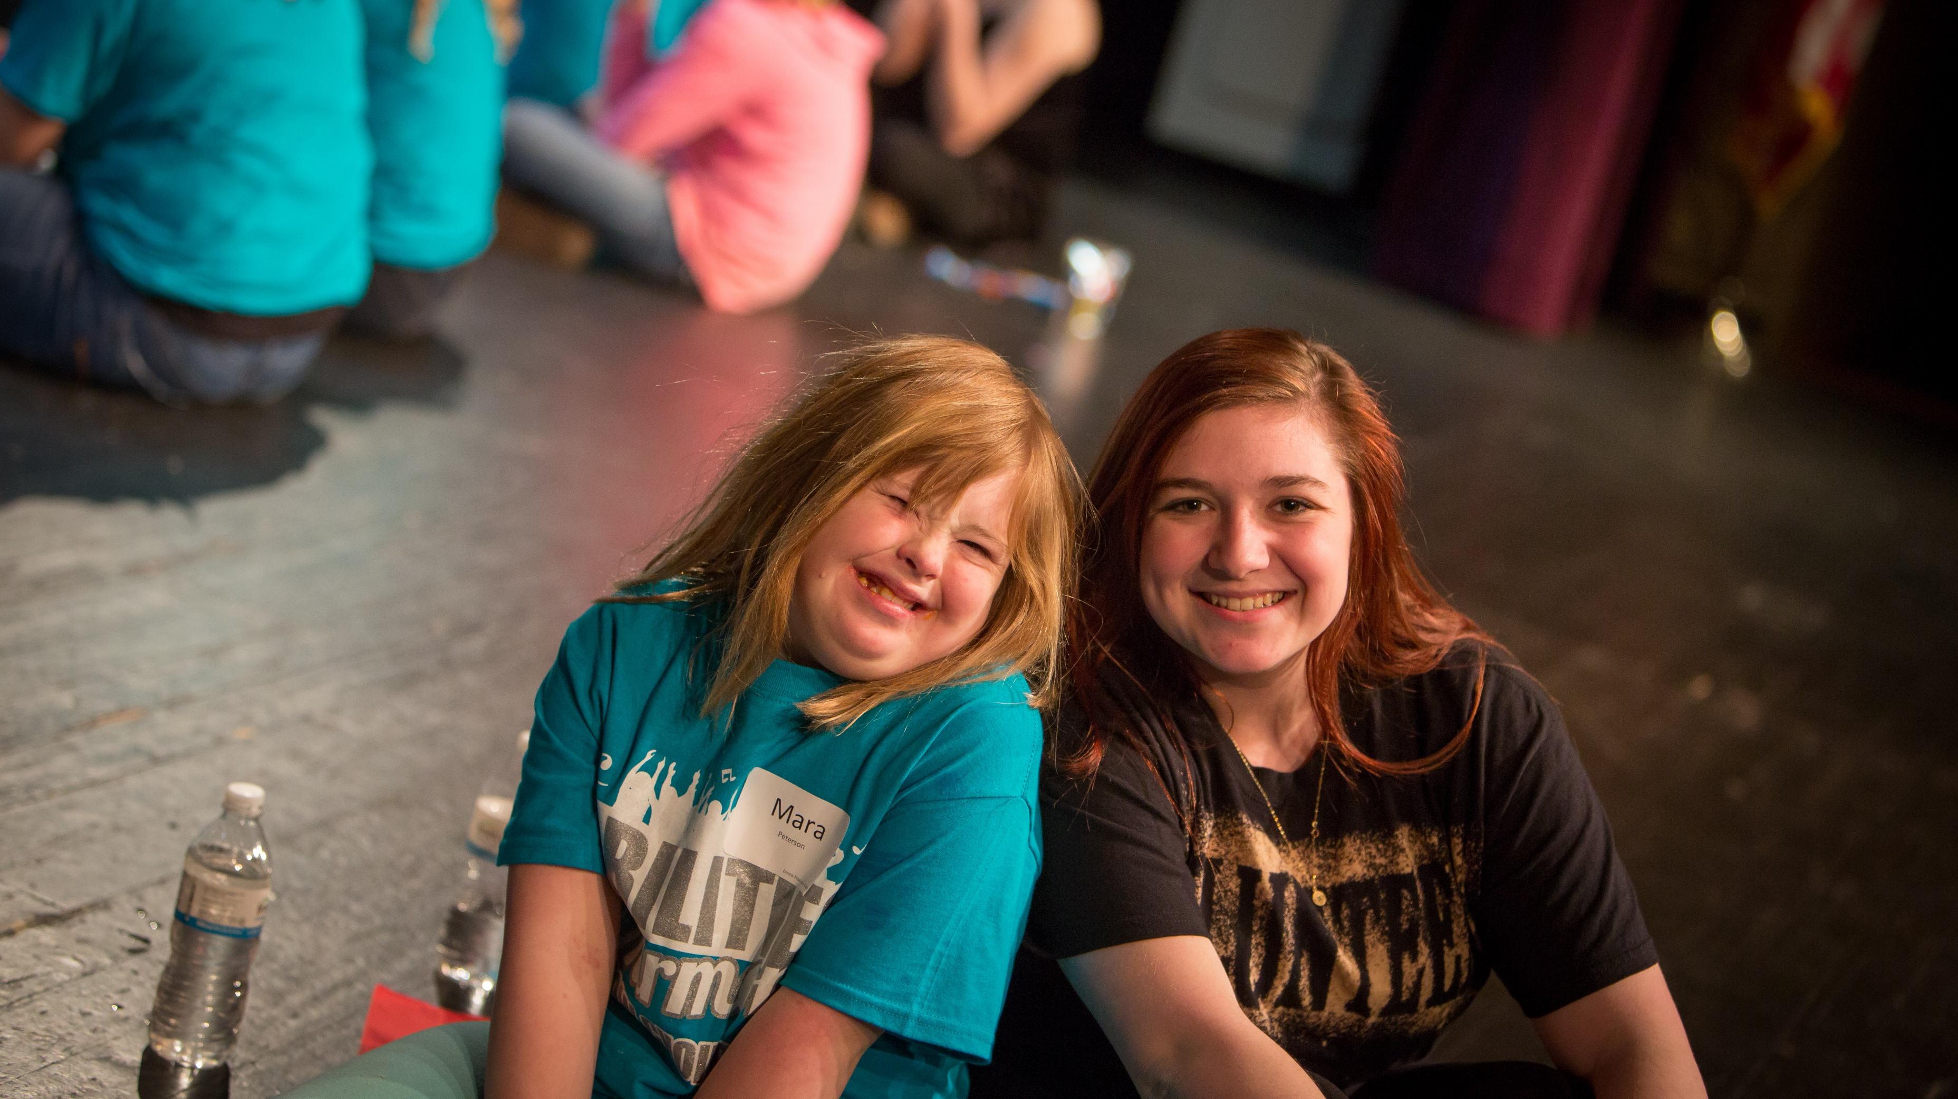
Our second camp was in February 2018 with double the campers!

Slide 7
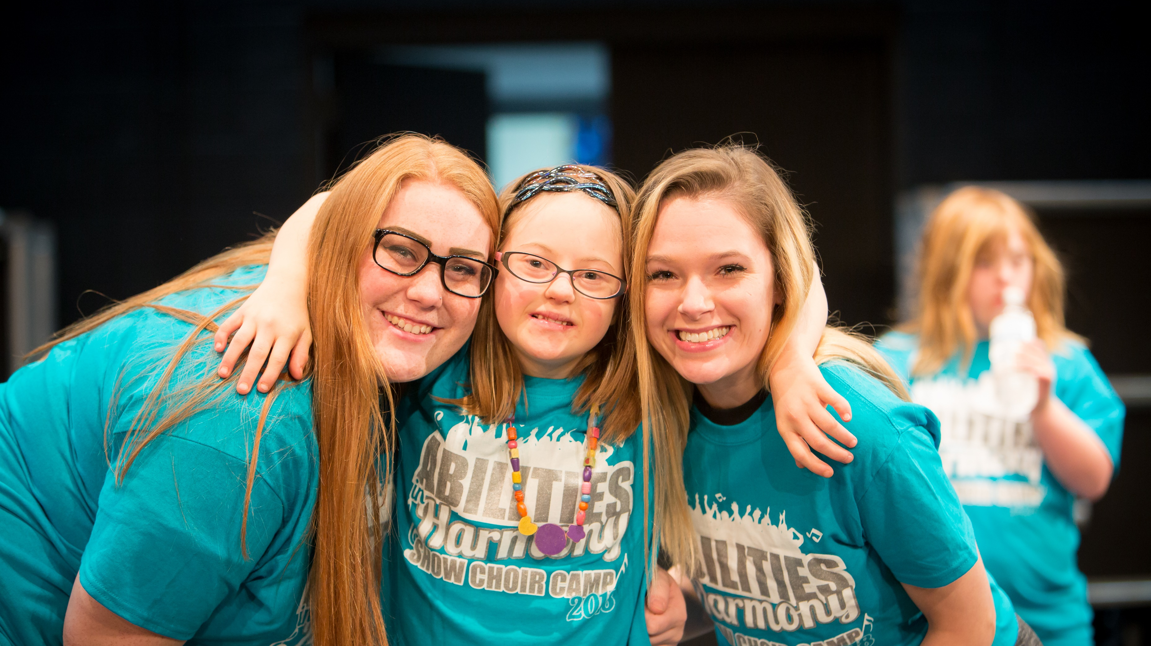

Slide 8
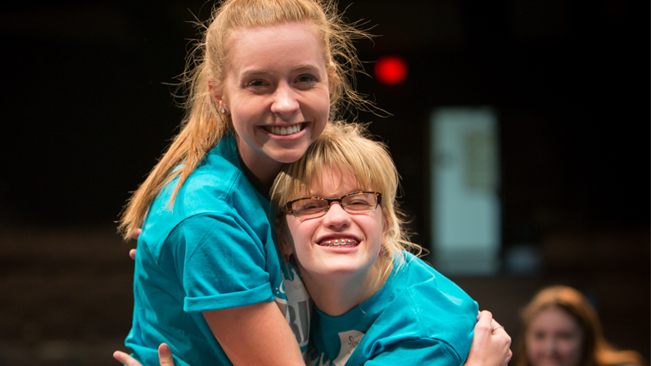

Slide 9
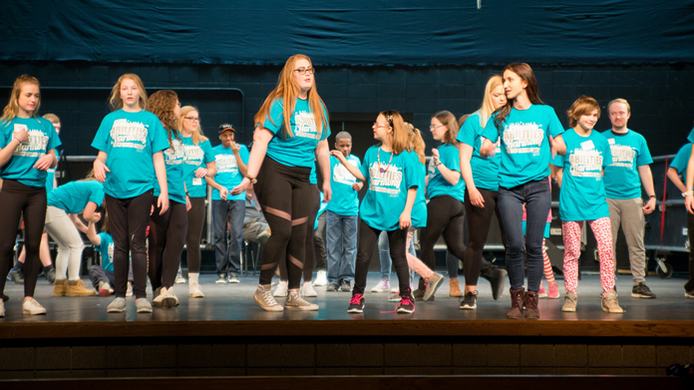

Slide 10
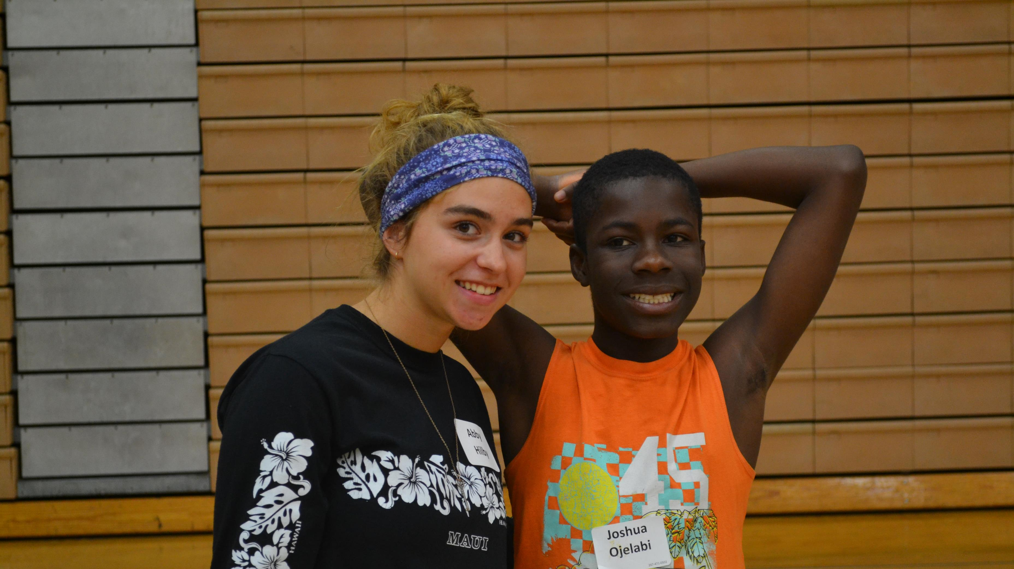
In July 2018, it got so big we split into two camps!

Slide 11
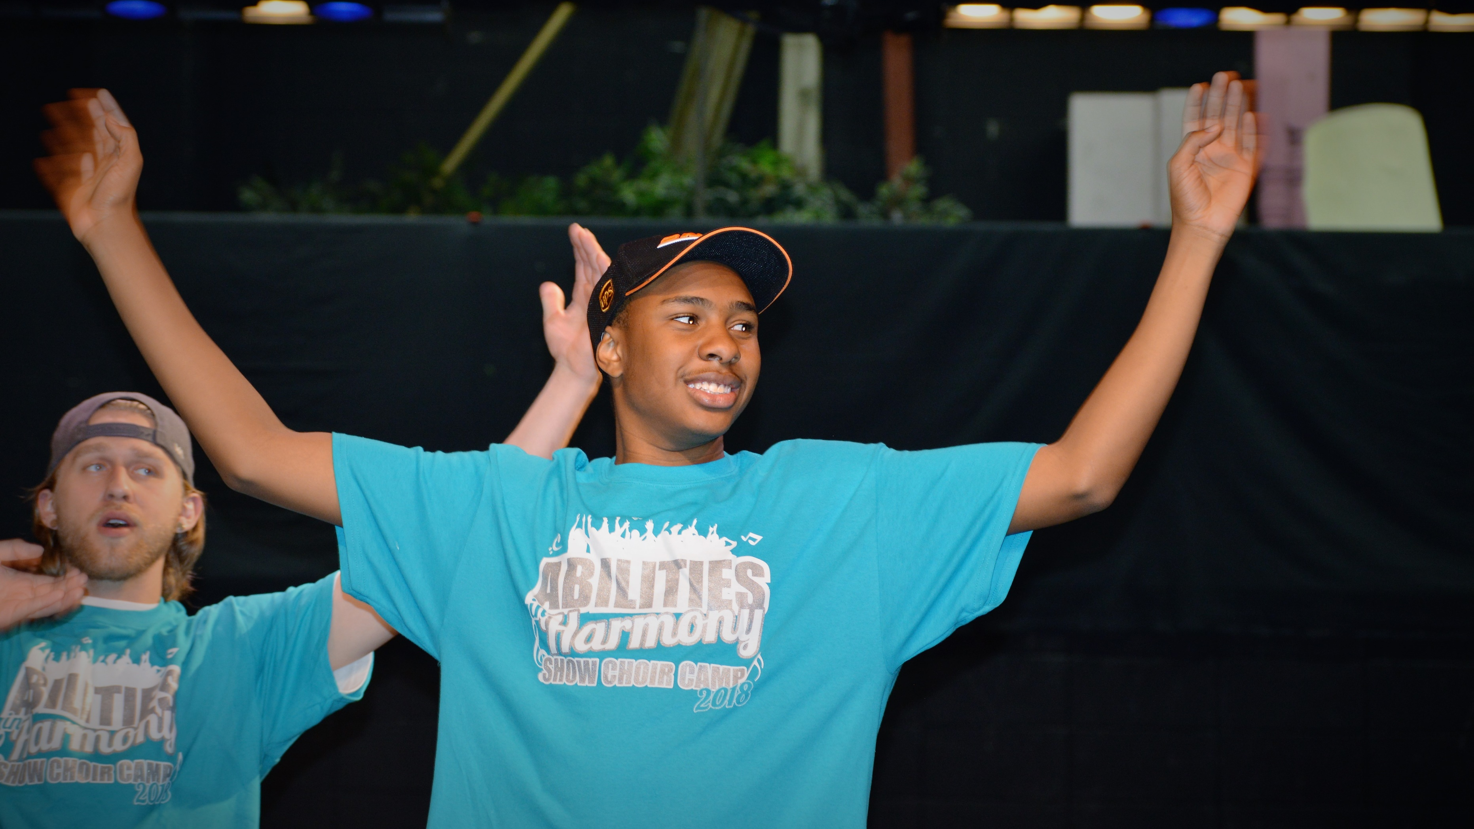
Then we got requests from all across the state to start a camp there!

Slide 12
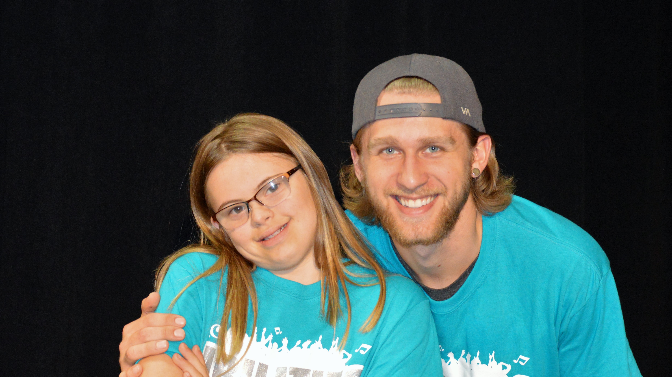
This summer we will be all across Wisconsin and Minnesota running camps!

Slide 13
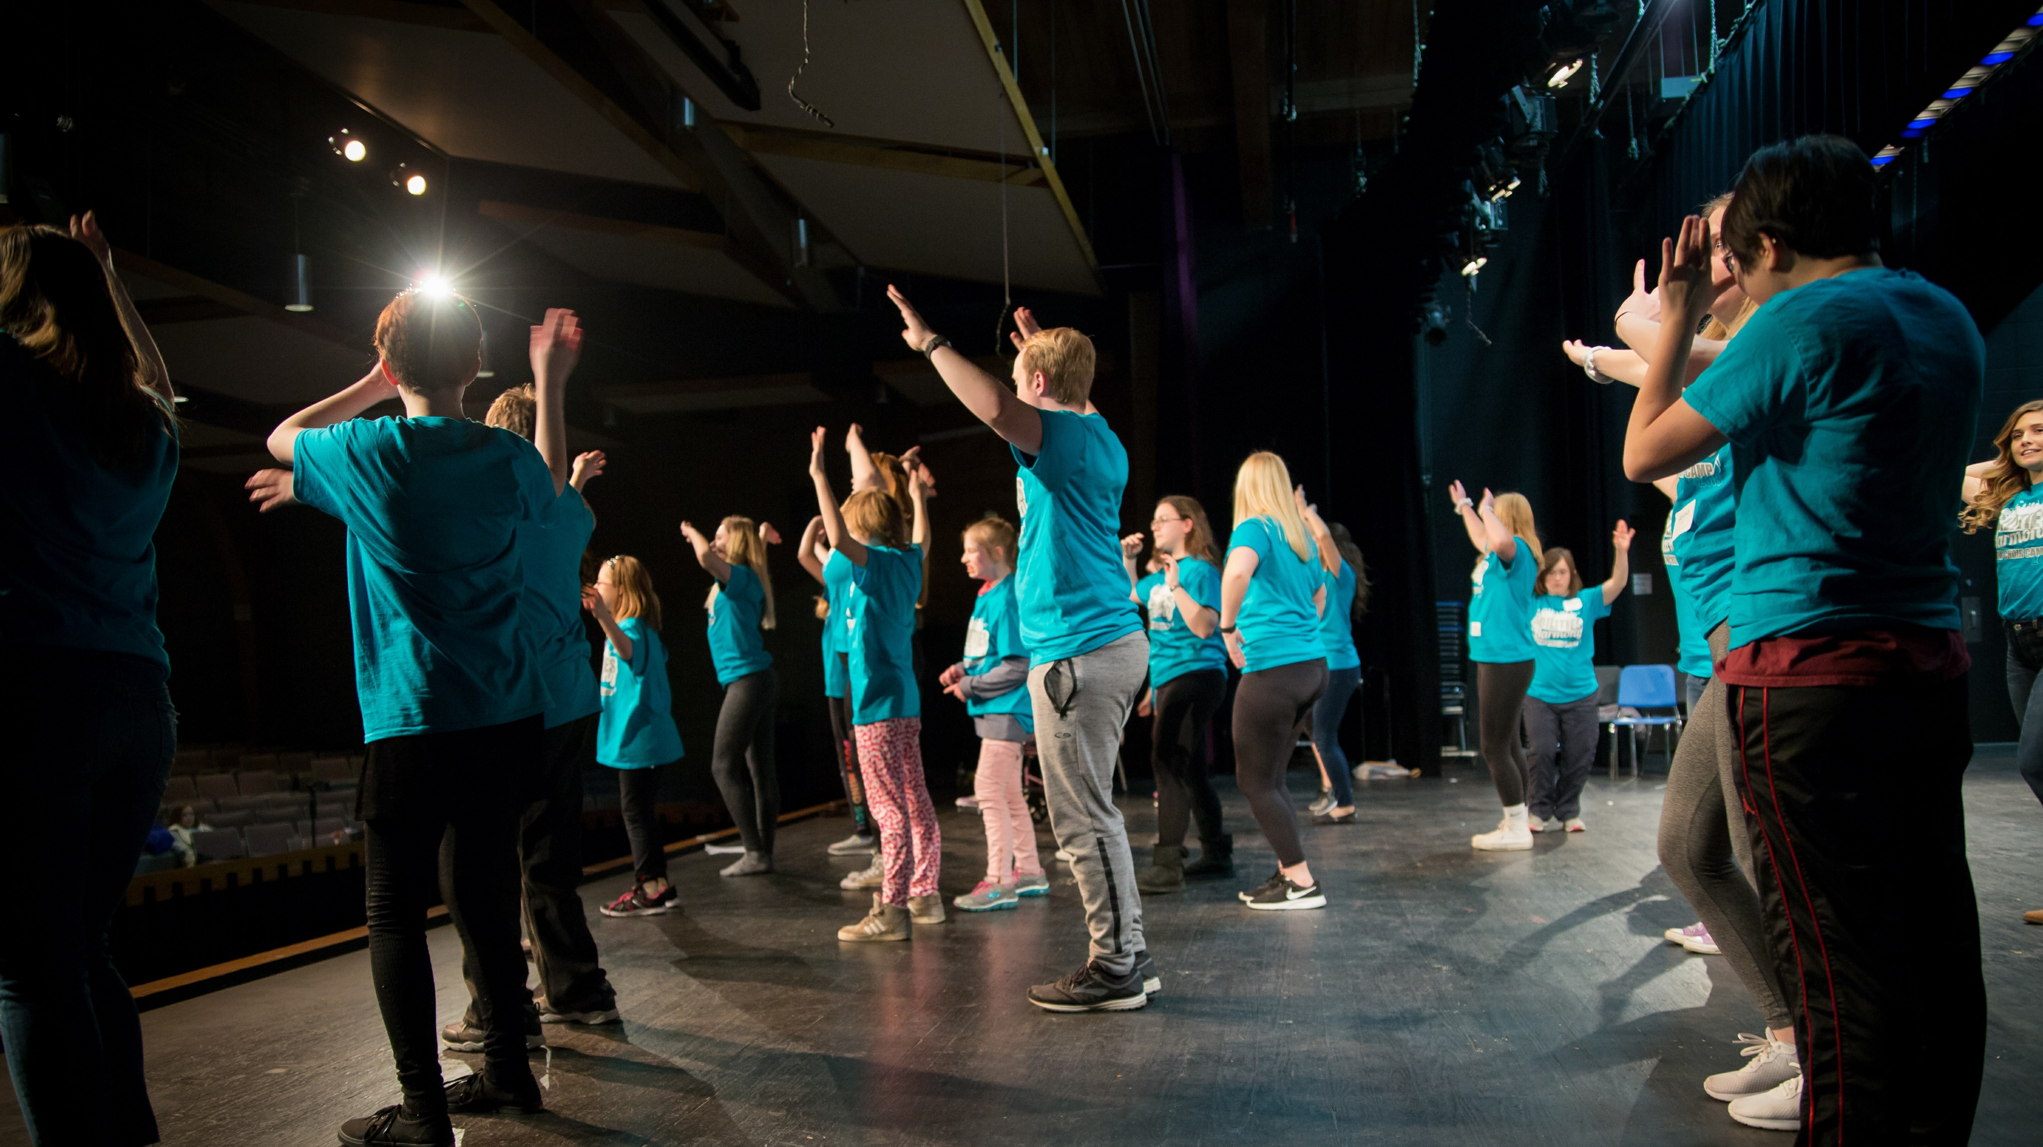
Camps are typically three 2-hour days long where we learn a show that we perform at the end!

Slide 14
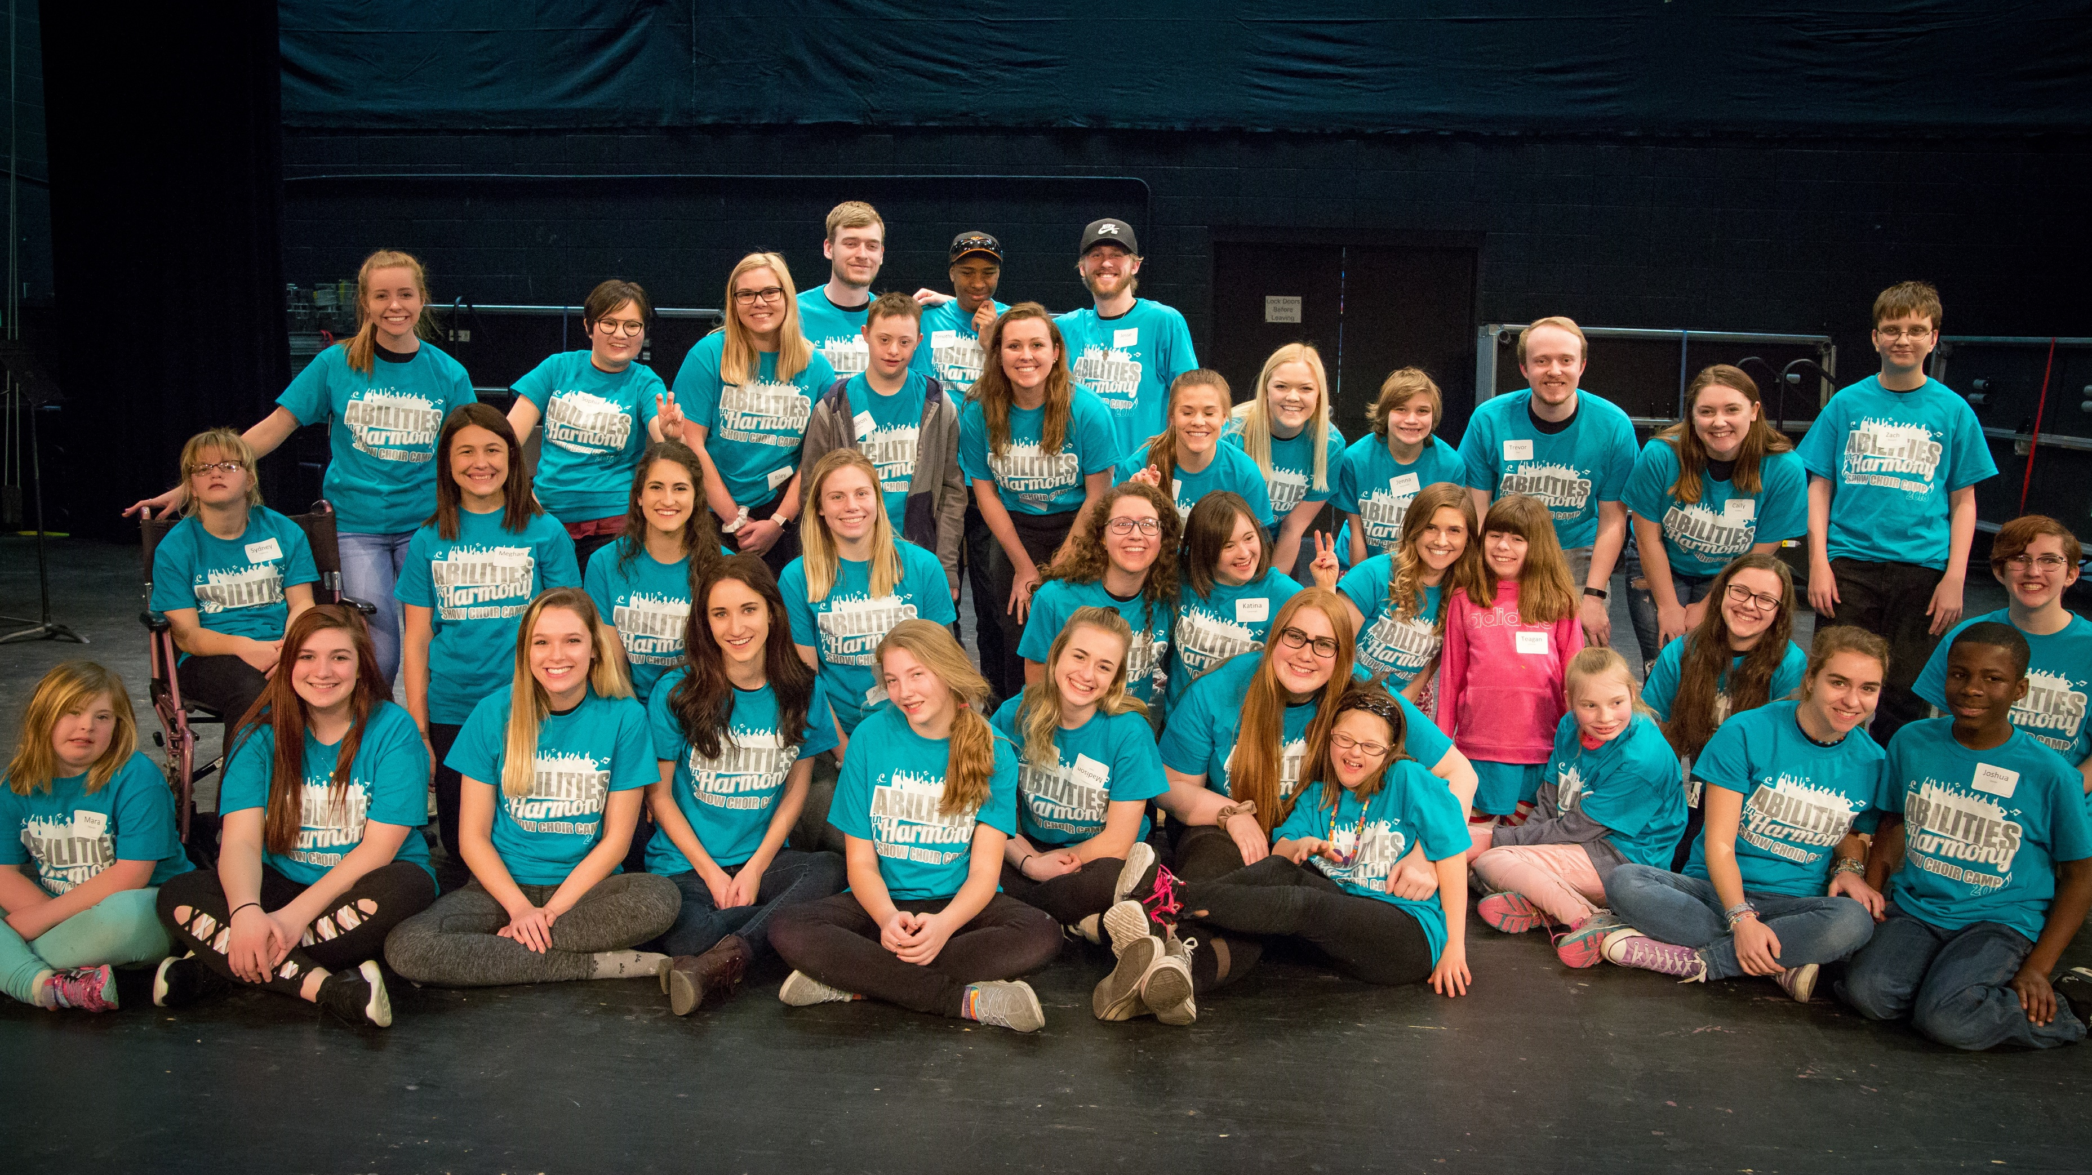
See our flyers about how you can help! Thanks for your support!

